Slide 1
Java Overview

Slide 2
What is Java?
Java is a high-level, object-oriented programming language.
It is developed by Sun Microsystems (now owned by Oracle Corporation) in the mid-1990s.

Slide 3
History of Java
Java was developed by James Gosling, who is known as the father of Java, in 1995.
Initially it was designed for small, embedded systems in electronic appliances like set-top boxes.
Firstly, it was called "Greentalk" by James Gosling, and the file extension was .gt.
After that, it was called Oak and was developed as a part of the Green project.
In 1995, Oak was renamed as "Java" because it was already a trademark by Oak Technologies.

Slide 4
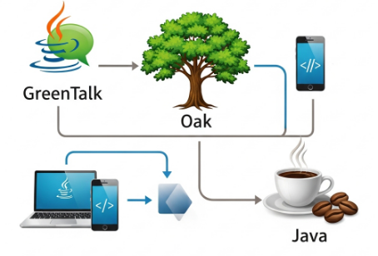
History of Java

Slide 5
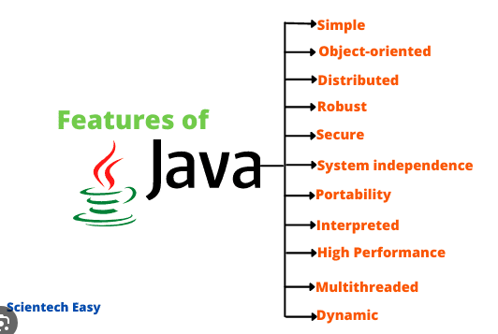
Features of Java

Slide 6
Comparison between C, C++, Java
Feature | C++ | Java
Platform Dependency | Platform Dependency | Platform Dependency
Memory Management | Manual memory management using new and delete | Automatic memory management with garbage collection
Compilation | Compiles directly to machine code using a compiler | Compiles directly to machine code using a compiler
Pointers | Supports pointers | Does not support pointers directly (for safety)
Multiple Inheritance | Supported using classes | Not supported with classes, but achievable using interfaces
Speed | Generally faster due to native compilation | Slightly slower due to JVM overhead

Slide 7
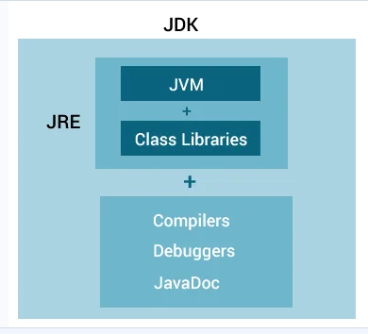
JDK(Java Development Kit)

Slide 8
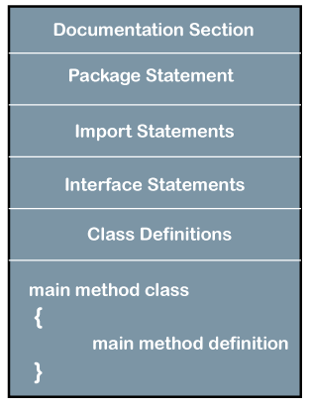
Java Program Structure

Slide 9
Hello World Program
public class MyFirstJavaProgram
{ public static void main(String []args)
{
System.out.println("Hello World");
}
}
Output:
C:\> javac MyFirstJavaProgram.java
C:\> java MyFirstJavaProgram
Hello World

Slide 10
Data Types in Java
Primitive Data Types
Primitive data types are predefined by the language and named by a keyword
Non Primitive Data Types
The non-primitive data types are not predefined.

Slide 11
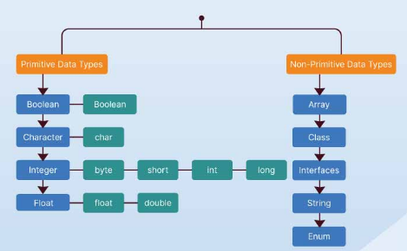
Data Types in Java

Slide 12
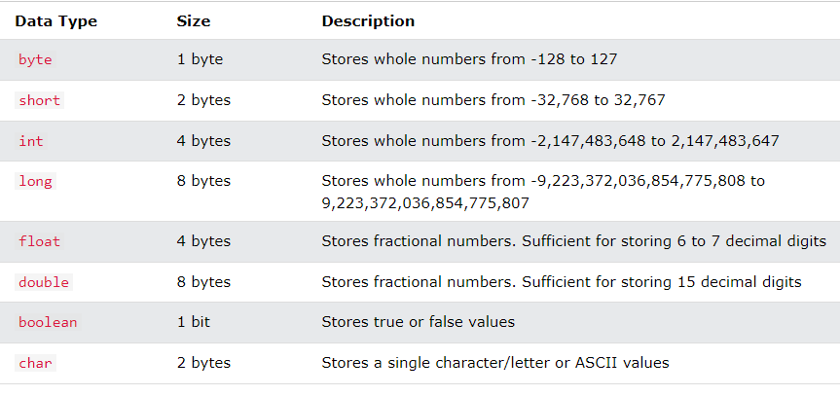
Primitive Data Types

Slide 13
Variables
Java variable is a name given to a memory location. It is the basic unit of storage in a program.
Syntax to declare a variable:
type variable name;
Example:
int number;

Slide 14
Variables
Java Variables Types
Local variables:
declared in methods, constructors, or blocks.
Instance variables
declared in a class, but outside a method, constructor or any block.
Class/Static variables
declared with the static keyword in a class, but outside a method, constructor or a block.

